Slide 1
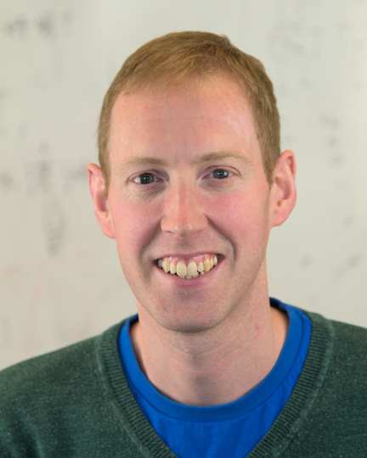
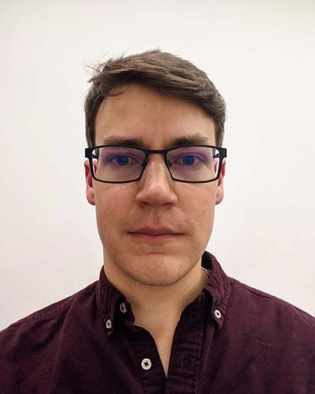
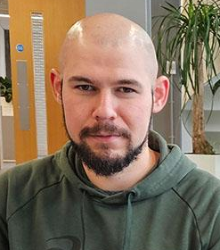
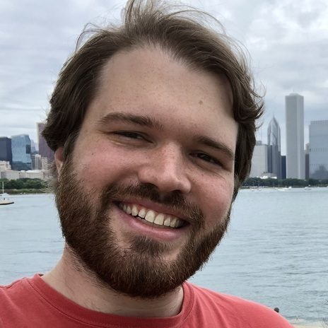



Welcome back for part two!
Nick Brown
EPCC University of Edinburgh
Leighton Wilson
Cerebras Systems
Justs Zarins
EPCC University of Edinburgh
David Kacs
EPCC University of Edinburgh

Slide 2
Session plan
Time | Title | Type
9:00 – 9:05 | Introduction, welcome and objectives | Presentation
9:05 – 9:25 | An Overview of the CS-2 architecture | Presentation
9:25 – 9:35 | Logging onto the CS-2 machine | Practical
9:35 – 10:35 | Practical walkthrough: Intro to SDK (CSL + Host Runtime) | Walk through
10:35 – 11:00 | Hands-on practical activity one | Practical
11:00 – 11:30 | ISC morning break
11:30 – 11:35 | Welcome back and overview of second part | Presentation
11:35 – 11:55 | Practical walkthrough: Using multiple PEs and communication | Walk through
11:55 – 12:45 | Hands-on practical activities two and three | Practical
12:45 – 12:52 | Wash up from practical activities | Presentation
12:52 – 13:00 | Conclusions and audience next steps to continue working with the technologies | Presentation

Slide 3
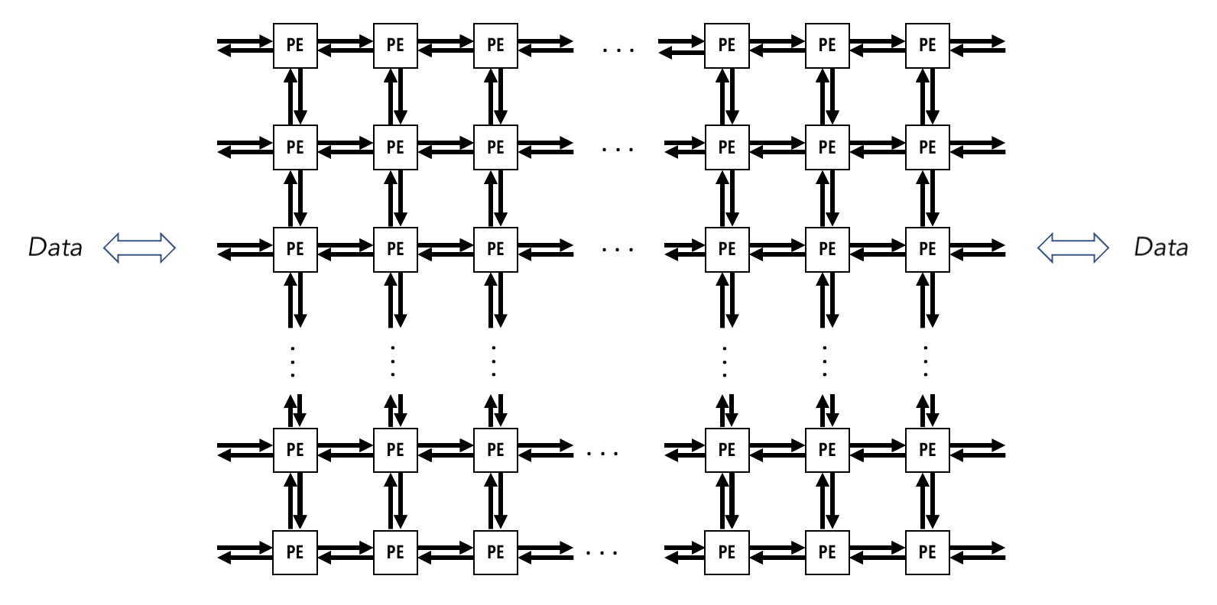
Hands on activity one
We are assuming that most people have managed to complete hands on activity one
Don’t worry if not, we can help you with it in the second hands on activity session of the tutorial
We have some specific wash up slides to talk you through on this to highlight the key points, and will do that towards the end of the session
In this second part of the tutorial we are going to focus on running over multiple Processing Elements (PEs) and communication between them

Slide 4

Reminder
All materials for this tutorial are open source and can be found at
https://github.com/EPCCed/cs2-sdk-training
There is in-depth documentation on the CSL and wider SDK available at
https://sdk.cerebras.net/csl

